Slide 1
Course Introduction
Prof. Dr. Dirk Riehle
Friedrich-Alexander University Erlangen-Nürnberg
AMOS A01
Licensed under CC BY 4.0 International
Notes:
It is Friedrich-Alexander University Erlangen-Nürnberg – FAU, in short.
Corporate identity wants us to say “Friedrich-Alexander University”.

Slide 2
Course Learning Goals 1 / 2 [1] [2] [3] [4]
To introduce students to agile methods by creating useful software.
[1] Professional = ambition + collaboration with external partner
[2] Agile methods = our focus here, specifically Scrum + XP
[3] We teach both overall processes as well as best practices
[4] Useful software is software that has value to someone!

Slide 3
Course Learning Goals 2 / 2
Learning objectives (lectures / tutorials, projects)
  Gain conceptual understanding and practical skills of using
    agile software development methods
    software project management tools
    software development tools
  Learn how to work
    with an external stakeholder
    in a (student) project team
Project objectives
  Develop useful software
  Perform a great demo on demo-day!

Slide 4



















Industry Partners and Teaching Projects
...

Slide 5
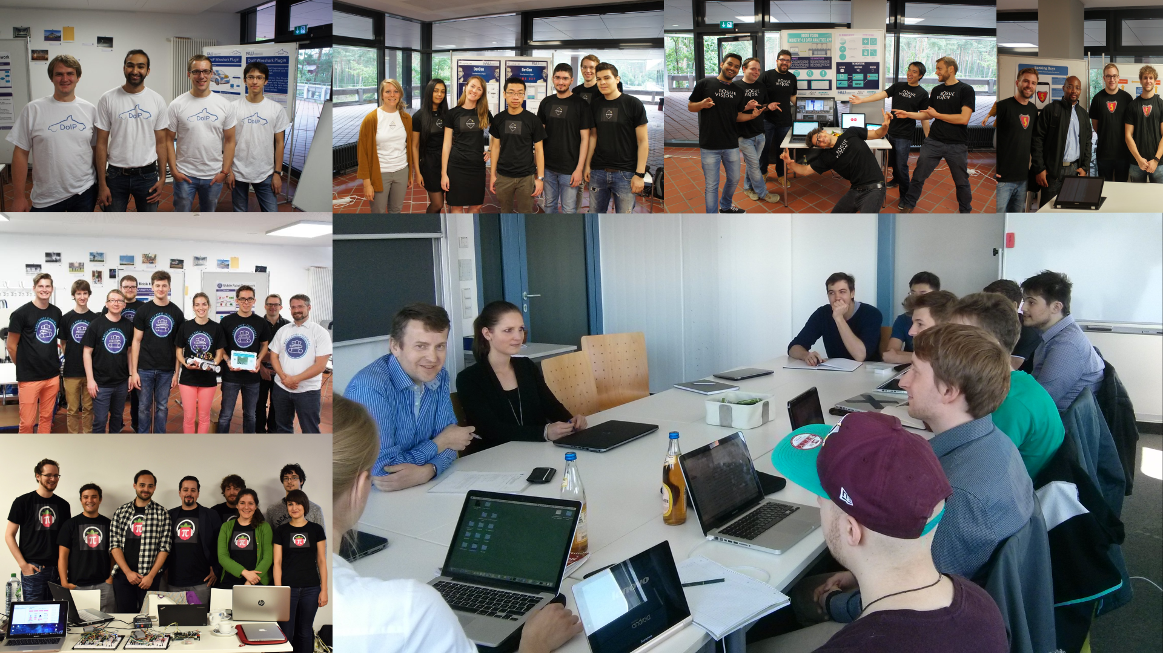

Slide 6
Skills Required for Course
General skills
  Willingness and ability to work in a team
  Ability to acquire skills during the project
Role-specific skills
  Product owner (PO) role
    Strong conceptual thinking
    Ability to communicate well
    Affinity to technology
  Software developer (SD) role
    Technology stack (specific to project)
    Development tools like git and GitHub
    Test-driven development
  Scrum master (SM) role
    Strong organizational skills

Slide 7
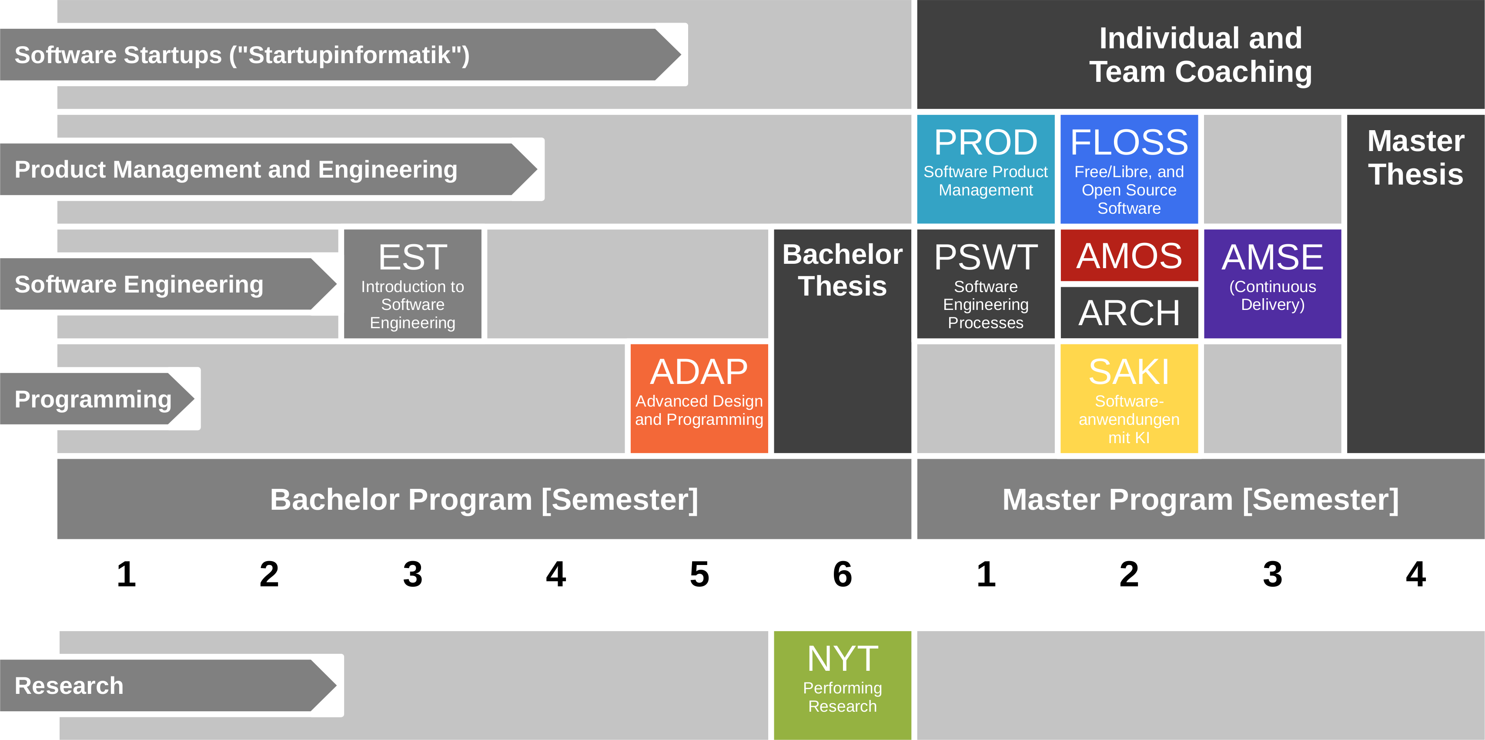
Course Position in Curriculum

Slide 8


Slide 9
Courses and Modules
 |  | Courses (Lehrveranstaltungen)
 |  | OSS-AMOS-VL | OSS-AMOS-UE (Team Meetings) | Total ECTS
Modules | OSS-AMOS-PO | x | x | 5
 | OSS-AMOS-SD | x | x | 10
NYT can be taken as
  5 ECTS VL + UE
  5 ECTS Seminar
  10 ECTS VL + UE
  10 ECTS Project
In various degree programs
Also as a Schlüsselqualifikation

Slide 10
Course Grading [1] (Separate Roles)
OSS-AMOS-PO (Product Owner)
  Theory (lectures) = 20% of grade
    2 SWS in 5 ECTS = 20%
    As measured by class quizzes
    Grading scale is [0..10] points
  Practice (project) = 80% of grade
    Individual contribution to teamwork = 50%
      As measured in team meetings
      Grading scale is [0|1|2|3]
    Independent work = 50%
      As measured by artifacts provided
      Grading scale is [0|1|2|3]
OSS-AMOS-SD (Software Developer)
  Theory (lectures) = 10% of grade
    2 SWS in 10 ECTS = 10%
    As measured by class quizzes
    Grading scale is [0..10] points
  Practice (project) = 90% of grade
    Individual contribution to teamwork = 50%
      As measured in team meetings
      Grading scale is [0|1|2|3]
    Independent work = 50%
      As measured by artifacts provided
      Grading scale is [0|1|2|3]
[1] Also see http://osr.cs.fau.de/teaching/course-resources/grading-schemes-and-scales/

Slide 11
Course Grading [1] (Integrated Roles)
Individual contribution to teamwork = 50%
  As measured in team meetings
  Grading scale is [0|1|2|3]
Independent work = 50%
  As measured by artifacts provided
  Grading scale is [0|1|2|3]
[1] Also see http://osr.cs.fau.de/teaching/course-resources/grading-schemes-and-scales/

Slide 12
Receiving a Grade for the Course
If you want to receive a grade
  You must register through the course management system before the deadline
If you cannot register through the course management system
  Please follow these instructions https://wp.me/PDU66-2bx
Otherwise: No grade

Slide 13

No Oral or Written Exam [1]
[1] You still have to register for the course

Slide 14
Course Language [1]
Class
  Lecturer: English
  Student: Choice of German or English
Project and exercises
  Team: Choice of German or English
  Submissions: Choice of industry partner
[1] http://osr.cs.fau.de/2012/03/10/english-or-german-deutsch-oder-englisch/

Slide 15
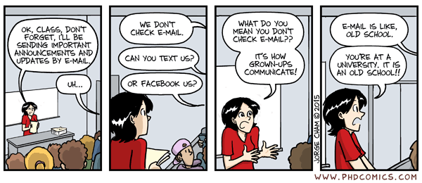
Course Communication
Announcements by email through course management system
Questions and answers using course communication forum
If you must send email, use the teaching team alias from Course index

Slide 16
Course Information
Course index
  See link in course management system

Slide 17
Thank you! Questions?
dirk.riehle@fau.de – http://osr.cs.fau.de
dirk@riehle.org – http://dirkriehle.com – @dirkriehle
DR

Slide 18
Credits and License
Original version
  © 2020 Dirk Riehle, some rights reserved
  Licensed under Creative Commons Attribution 4.0 International License
Contributions
  None yet

